Slide 1


GENERATIVE AI
Laya Shree Elango

Slide 2
WHAT IS GEN AI?
Generative AI refers to AI systems capable of creating new content, such as text, images, or videos, based on patterns and data they've been trained on.

Slide 3


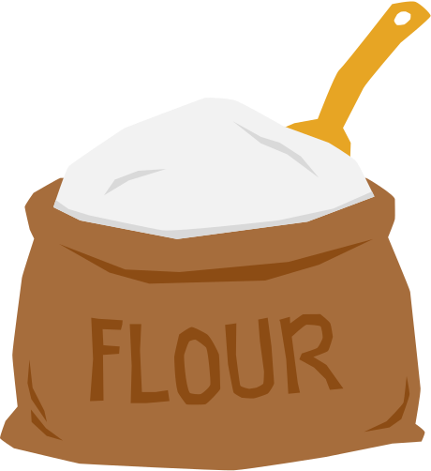
WHAT IS GEN AI?

Slide 4
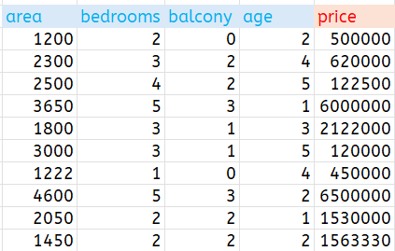
JOURNEY FROM ML TO GENERATIVE AI
Eg: House Price Prediction
Statistical ML
Structured Data

Slide 5
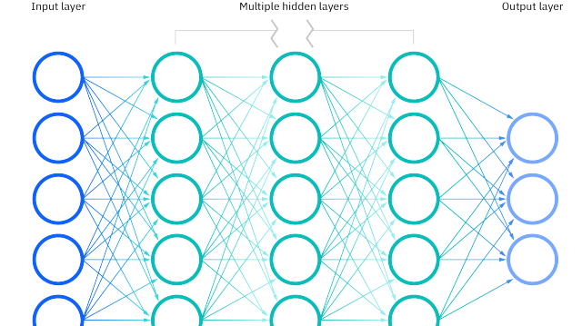



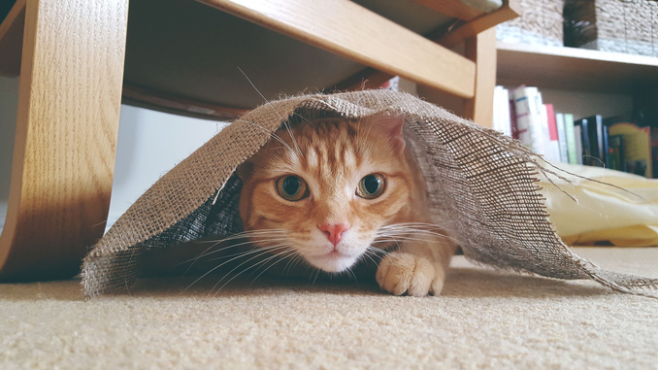
JOURNEY FROM ML TO GENERATIVE AI
Classification
pointy ears
whiskers
Neural Networks
Unstructured Data

Slide 6
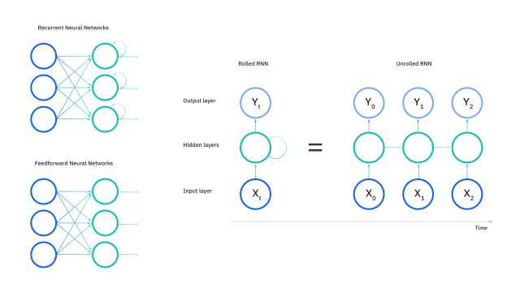
JOURNEY FROM ML TO GENERATIVE AI
Recurrent Neural Networks (RNN)
movie was great

Slide 7
JOURNEY FROM ML TO GENERATIVE AI
Angela: Hey we have a potential collaboration opportunity. Do you have time to talk?
Dhaval: Angela, Thanks for _________
contacting me 0.91
reaching out 0.96
finishing project 0.24

Slide 8




Semi-Supervised learning
hidden
input
output

Slide 9
LLM
It is an extremely large AI model that can predict the next word or set of words from the given sequence of words, enabling them to generate coherent and contextually appropriate text.
Eg: If I say "Once upon a time, there was a...", a language model can predict "princess" or "dragon" based on the context.

Slide 10
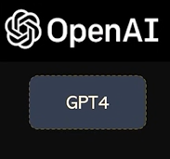
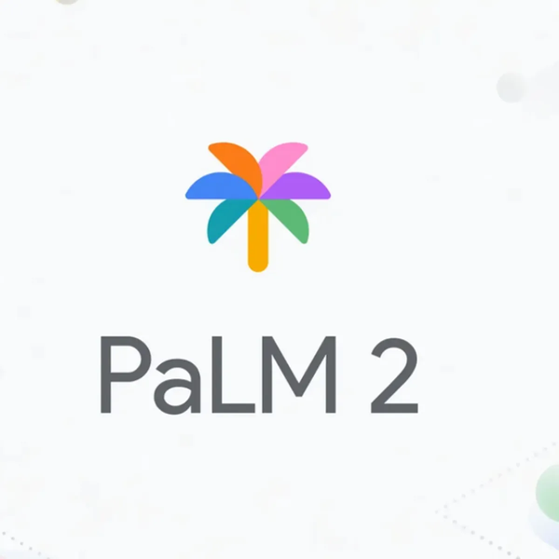
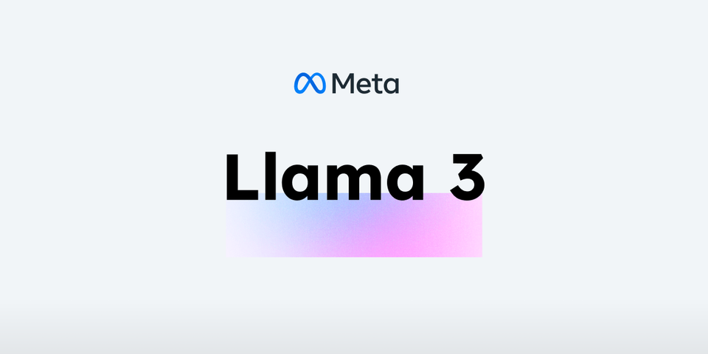
POPULAR LLM MODELS
OpenAI
Google
Meta

Slide 11
RLHF
One of the key methods in improving Generative AI is Reinforcement Learning from Human Feedback, or RLHF. This is where AI gets better through feedback provided by humans,

Slide 12
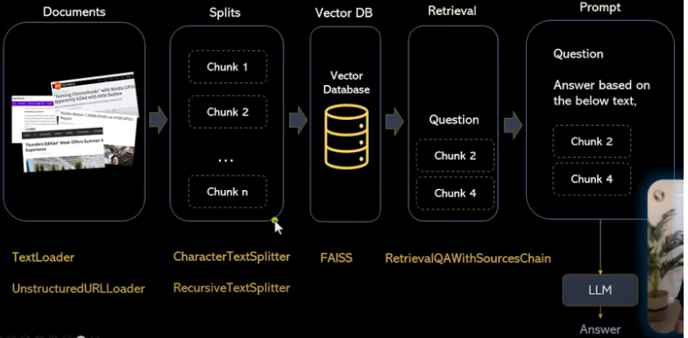
LLM APP ARCHITECTURE

Slide 13
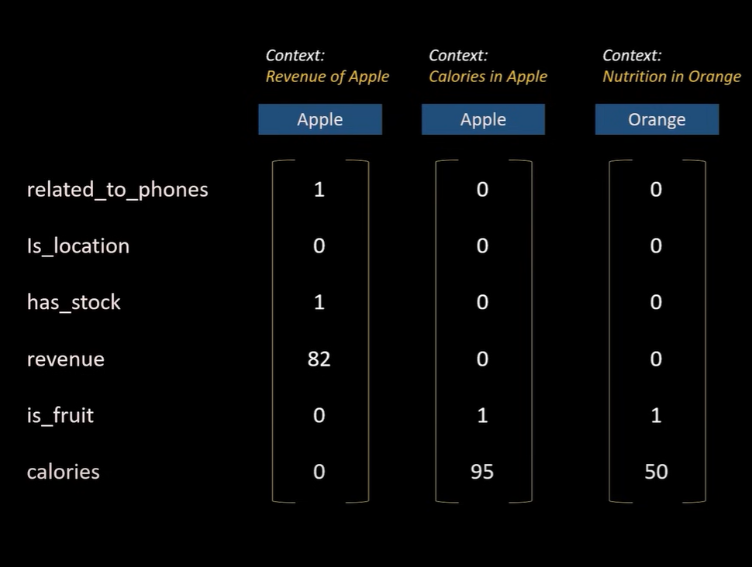
EMBEDDINGS
Numeric representations of text in vectors that capture the meaning of words.

Slide 14
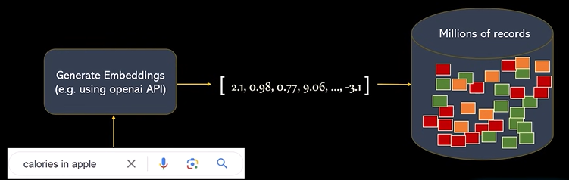
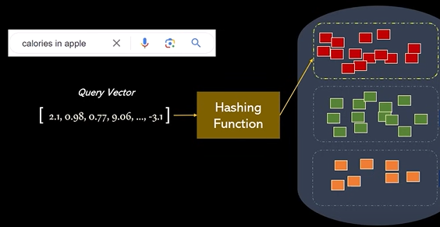
VECTOR DATABASE
hashing technique: Locality Senisitive Hashing

Slide 15
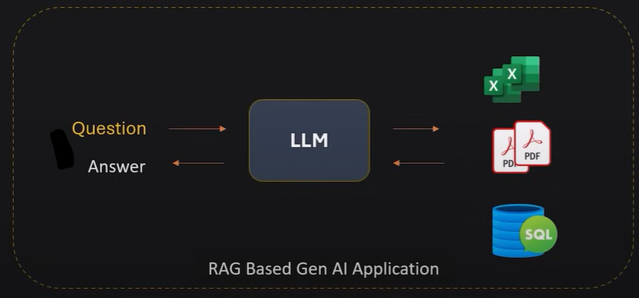
RAG
Retrieval Augmented Generation a technique where generative models retrieve relevant information from a database before generating new content.

Slide 16
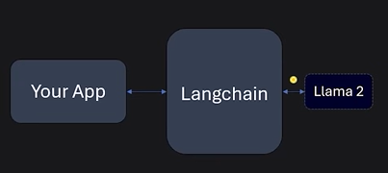
LANGCHAIN
Python library that makes building LLM apps easier

Slide 17
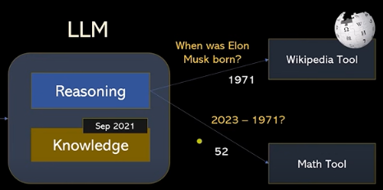
LANGCHAIN
Python library that makes building LLM apps easier

